Slide 1

Healthcare
WGS Accum ODS
Version 1, May 2015

Slide 2
Copyright

Slide 3

Agenda
Agenda
Overview
Background
Current State
Pain Points

Slide 4

Overview
WGS Accum ODS
Anthem is proposing changes to Accum ODS functioning and here are the vision statements.
Accum ODS should function like a financial system with consistency and sanctity of the transactions.
Capture analytics about how well the Accum ODS is functioning
Treat the Accum ODS like a micro-service to gain autonomy and maintain isolation from other systems changes

Slide 5
Background
WGS Accum ODS
The Accumulator Operations Data Store (ODS) is where the out-of-pocket maximum accumulators are shared, are stored. This application will be used to support commingling of cost-shares toward a single out-of-pocket maximum for Anthem products.
.
Commingling must be indicated on the WGS Contract Profile through group set-up
Membership and product information is electronically transmitted to the Accum ODS including contract codes, accumulation name and benefit limits
Claims reads the Accum ODS in real-time to get current values using Medical Member IDs and processes, subject to the member’s current contract benefits
Accum ODS uses Medical IDs for inquiry and updates
Accum ODS supports P2P transfer when member switches product and his availed benefit accumulators are transferred to new product if applicable.

Slide 6
Micro-Services for Accums ODS – Key Considerations.
WGS Accum ODS
Foundation:
Consistency
Build Audit/Log structure to support analytics to bring in consistency for real time and batch transactions. Current structure doesn’t support auditing and reporting.
Improve the integration layer to speed up the response
Reduce network latency by introducing IMSconnect or improved MQ integration layer.
Function:
1. Scalability
Bring in microservice layer to scale up the ODS service by breaking down functions and building separate services.
2. Agility
Maintain autonomy of the service by eliminating or reducing points of coupling

Slide 7
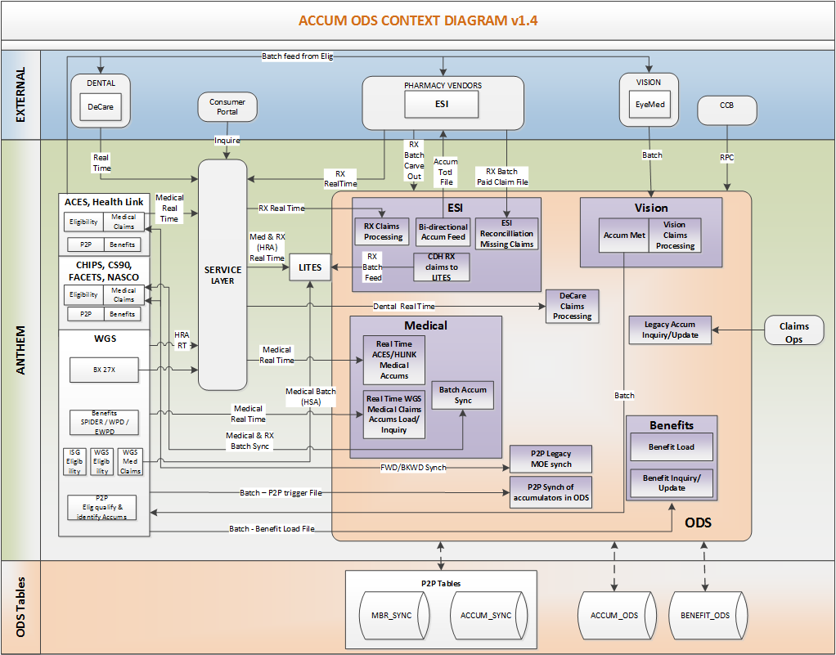
Current State
WGS Accum ODS

Slide 8

Pain Points
WGS Accum ODS
Problem | Cause | UST Global Involvement | Next Steps
Current architecture doesn’t support Tracking, Auditing, Reporting of accumulator transactions. | SPLUNK logging is not registering all the transactions. Direct accumulator update through WGS transactions and batch processing are not captured in the back end. | Approach document on mainframe solution was shared with Kevin | Finalize the design and come up with timelines
Duplicate records are getting inserted in accumulator ODS creating incorrect claim payments causing adjustments. | Slow response triggers time outs in SOA layer causing source systems to resubmit transactions resulting in duplicate updates. Peripheral applications’ downtime causing Accum calls to fail | Approach document on solution was shared with Kevin | Finalize the design and come up with timelines

Slide 9
Pain Points
WGS Accum ODS
Problem | Cause | UST Global Involvement | Next Steps
Source specific business logic in the accum ODS layer. This is against the guiding principles of autonomy and isolation from source system changes. | Source system limitations has forced those business logic to be part of ODS layer. | Documented all the system specific logic and shared with Kevin Updated ODS component inventory and shared with Kevin | Co-ordinate discussions with source systems and come up with approach to remove system specific logic from ODS layer and be part of source system logic.
MOE(Member Other Enrollment) File is providing inconsistent data. | MOE file is using SOA service ‘getContractList’ which doesn’t handle application exception and any failure on the eligibility call to legacy E&B systems results in inconsistent data. | Analysis is in progress to look at the possibility of using member micro services | Finalize the analysis and come up with approach document.

Slide 10
Pain Points
WGS Accum ODS
Problem | Cause | UST Global Involvement | Next Steps
Accum ODS Integration layer is making additional message hops slowing the transaction. | Current structure makes 11 message hops before reaching the mainframe to get the ODS data. Some of these message hops are redundant and can be avoided. | Analyze each message request and response layer and confirm some are redundant and can be cut down | Finalize the analysis and come up with approach document

